Slide 1


High-Level BioDesign Automation
Jacob Beal
SemiSynBio
February, 2013

Slide 2
Overview
Is biology too hard for abstraction?
High-Level BDA is possible now!
Tool-chains for BDA
Compiling from HLL to biological circuits
Building computational device libraries

Slide 3
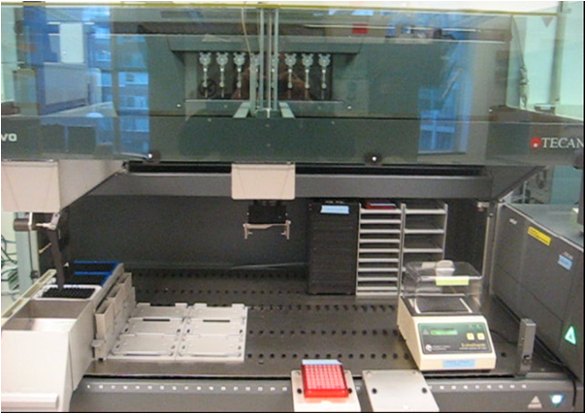

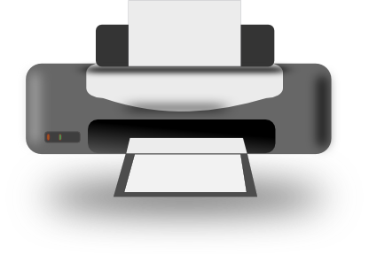
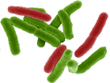

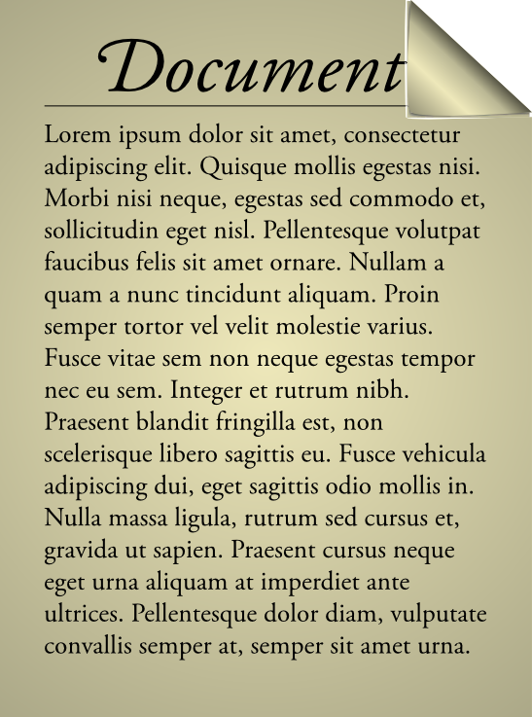
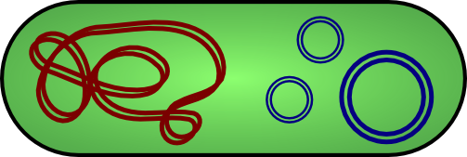
Vision: WYSIWYG Synthetic Biology
Bioengineering should be like document preparation:

Slide 4
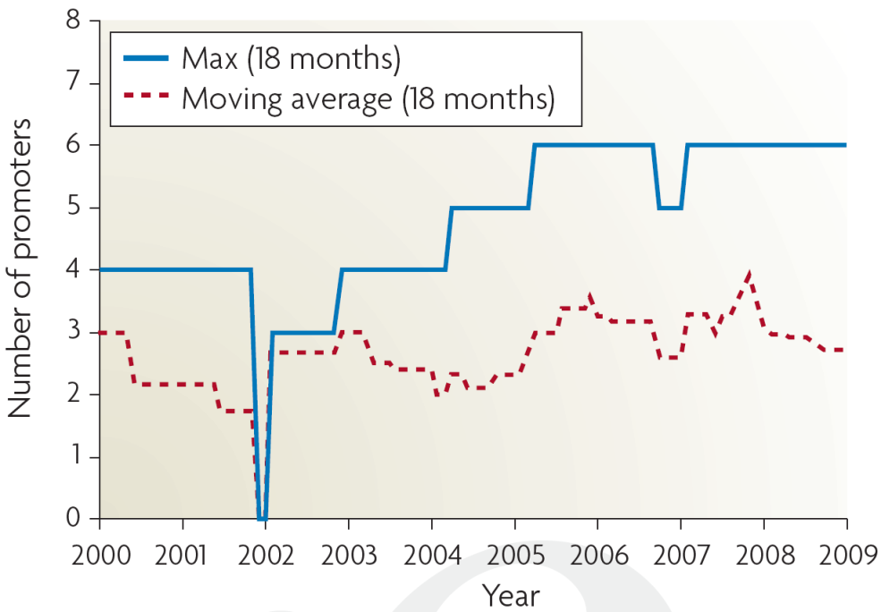
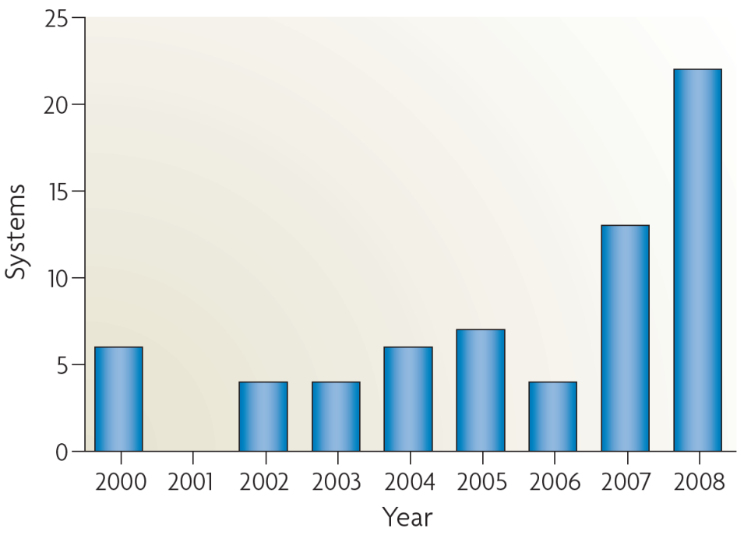
Why is this important?
Breaking the complexity barrier:
Multiplication of research impact
Reduction of barriers to entry
?
DNA synthesis
Circuit size
[Purnick & Weiss, ‘09]
*Sampling of systems in publications with experimental circuits

Slide 5
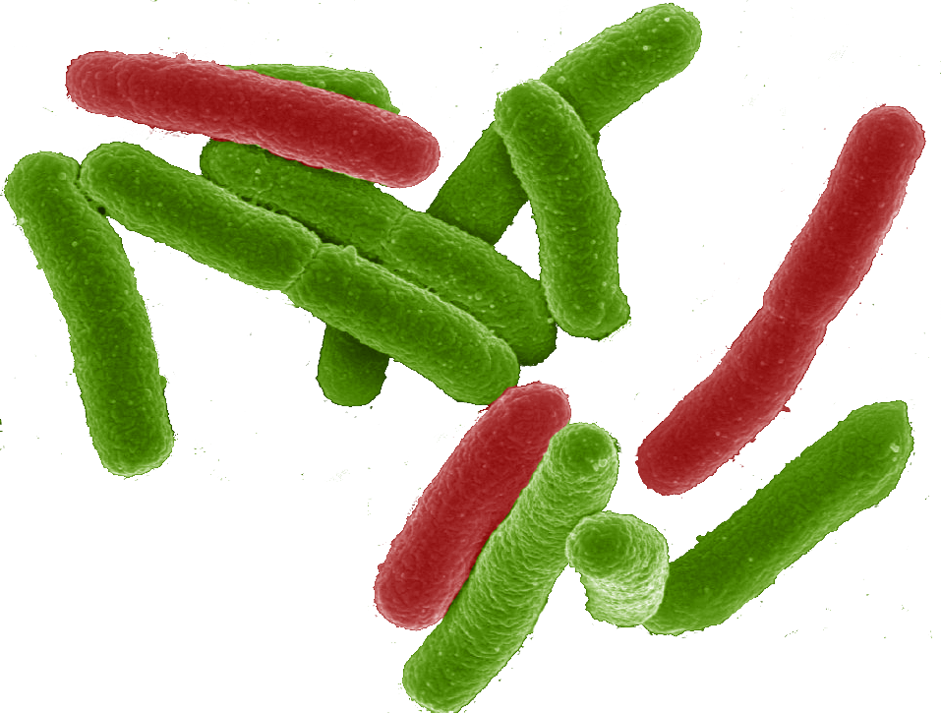
Why a tool-chain?
Organism Level Description
This gap is too big to cross with a single method!
Cells

Slide 6
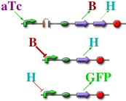
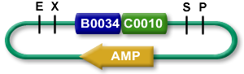

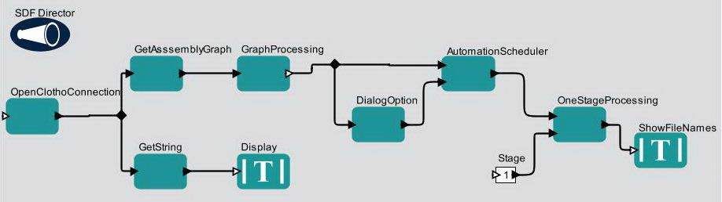

The TASBE tool-chain architecture:
Organism Level Description
High level simulator
High Level Description
If detect explosives:
emit signal
If signal > threshold:
glow red
Coarse chemical simulator
Abstract Genetic Regulatory Network
Detailed chemical simulator
DNA Parts Sequence
Modular architecture also open for flexible choice of organisms, protocols, methods, …
Collaborators:
Assembly Instructions
Ron
Weiss
Testing
Douglas Densmore
Cells

Slide 7
A Tool-Chain Example
If detect explosives:
emit signal
If signal > threshold:
glow red
(def simple-sensor-actuator ()
(let ((x (test-sensor)))
(debug x)
(debug-2 (not x))))
Mammalian Target
E. coli Target

Slide 8
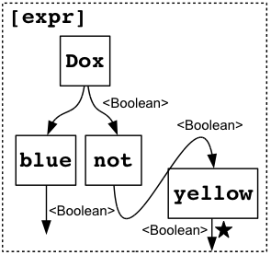
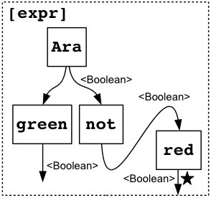
A Tool-Chain Example
If detect explosives:
emit signal
If signal > threshold:
glow red
Mammalian Target
E. coli Target

Slide 9
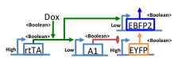
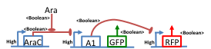
A Tool-Chain Example
If detect explosives:
emit signal
If signal > threshold:
glow red
Mammalian Target
E. coli Target

Slide 10
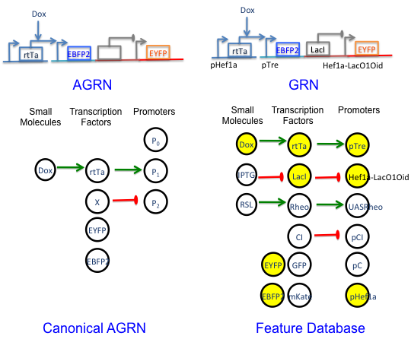
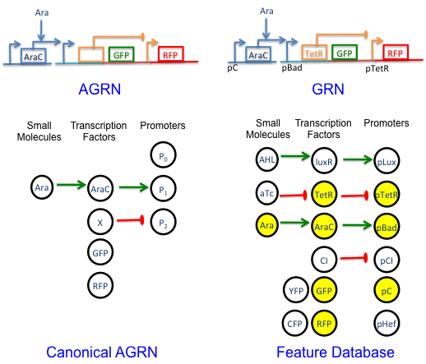
A Tool-Chain Example
If detect explosives:
emit signal
If signal > threshold:
glow red
Mammalian Target
E. coli Target

Slide 11
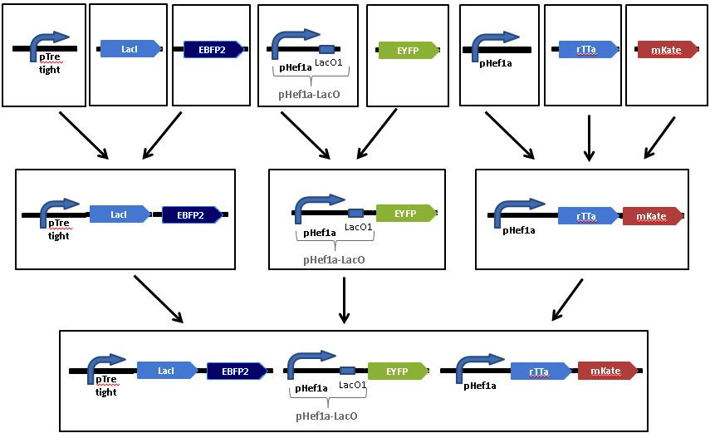
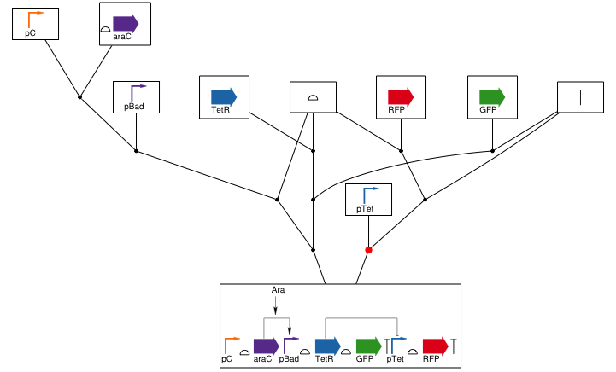
A Tool-Chain Example
If detect explosives:
emit signal
If signal > threshold:
glow red
Mammalian Target
E. coli Target

Slide 12
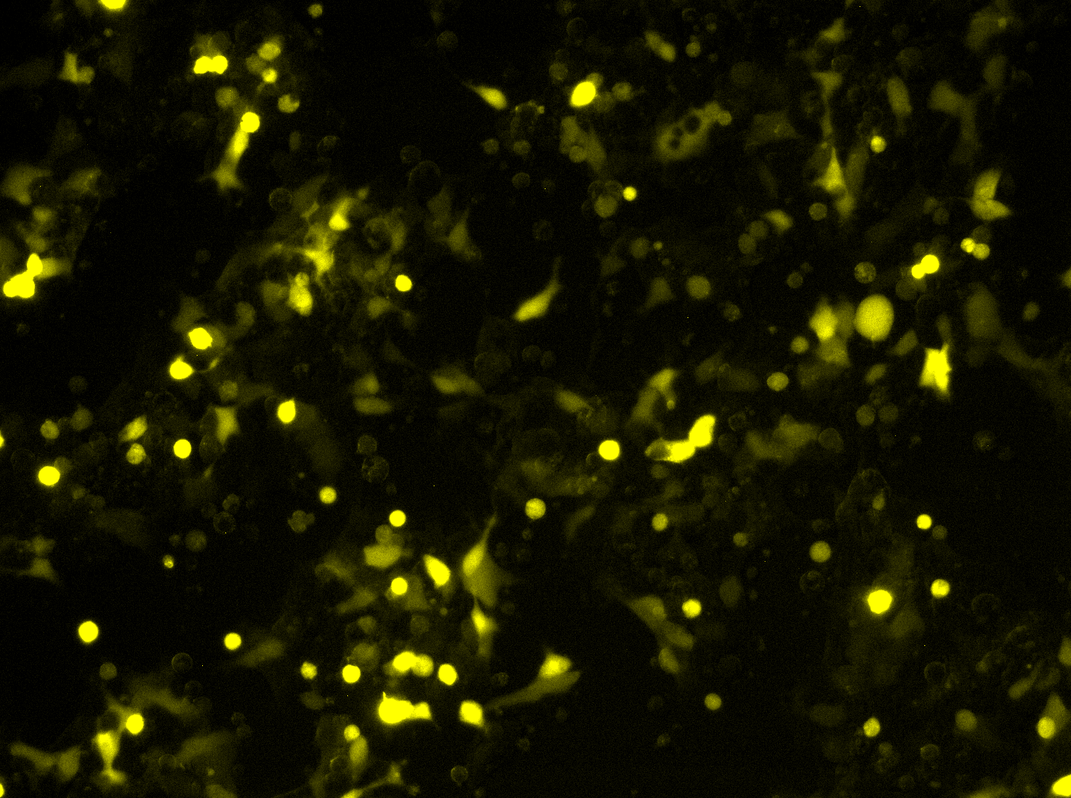
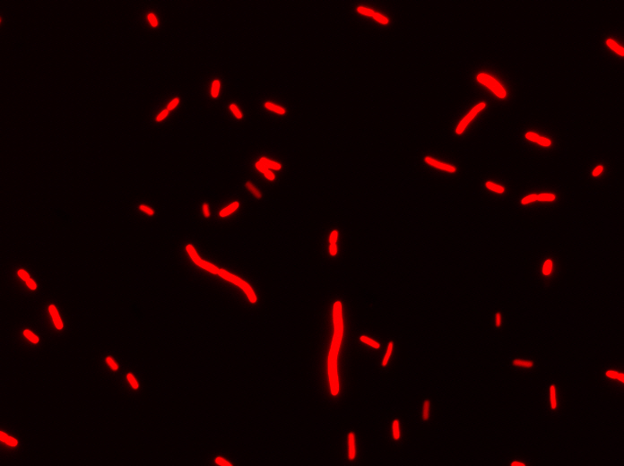

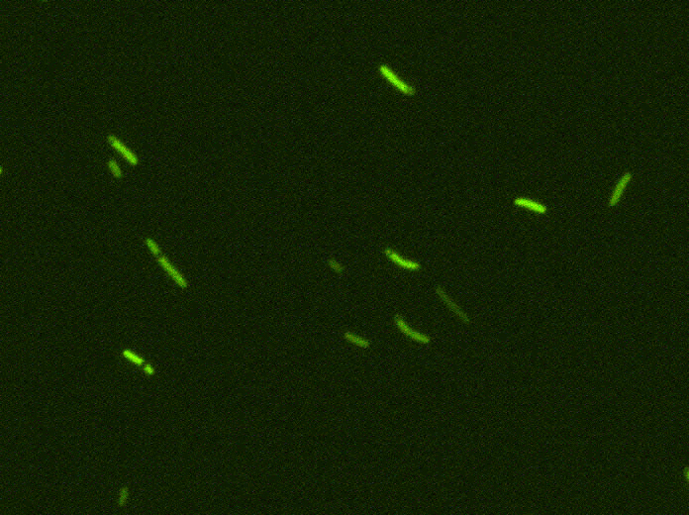
A Tool-Chain Example
Uninduced
Uninduced
If detect explosives:
emit signal
If signal > threshold:
glow red
Induced
Induced
Mammalian Target
E. coli Target

Slide 13
Focus: BioCompiler
Organism Level Description
High level simulator
High Level Description
Compilation &
Optimization
If detect explosives:
emit signal
If signal > threshold:
glow red
Coarse chemical simulator
Abstract Genetic Regulatory Network
Detailed chemical simulator
DNA Parts Sequence
Other tools aiming at
high-level design:
Cello, Eugene, GEC,
GenoCAD, etc.
Assembly Instructions
Testing
Cells

Slide 14
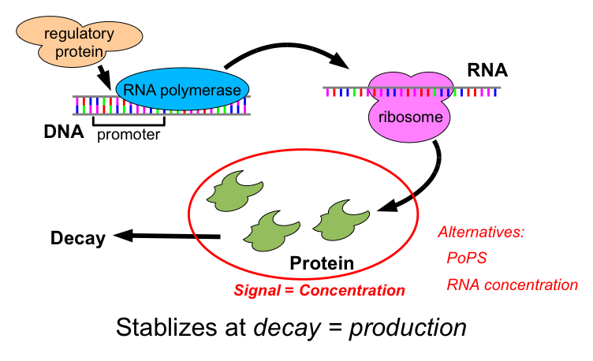
Transcriptional Logic Computations

Slide 15
Motif-Based Compilation
Operators translated to motifs:
IPTG
not
green
IPTG
A
B
LacI
outputs
arg0
outputs
arg0
GFP
outputs
IPTG
LacI
A
B
GFP

Slide 16
Design Optimization
(def sr-latch (s r)
(letfed+ ((o boolean (not (or r o-bar)))
(o-bar boolean (not (or s o))))
o))
(green (sr-latch (aTc) (IPTG)))
IPTG
GFP
LacI
B
I
F
E1
E2
D
I
aTc
C
J
H
G
TetR
A
J
Unoptimized: 15 functional units, 13 transcription factors

Slide 17
Design Optimization
(def sr-latch (s r)
(letfed+ ((o boolean (not (or r o-bar)))
(o-bar boolean (not (or s o))))
o))
(green (sr-latch (aTc) (IPTG)))
IPTG
F
GFP
H
LacI
TetR
aTc
Final Optimized:
5 functional units
4 transcription factors
H
F
Unoptimized: 15 functional units, 13 transcription factors

Slide 18
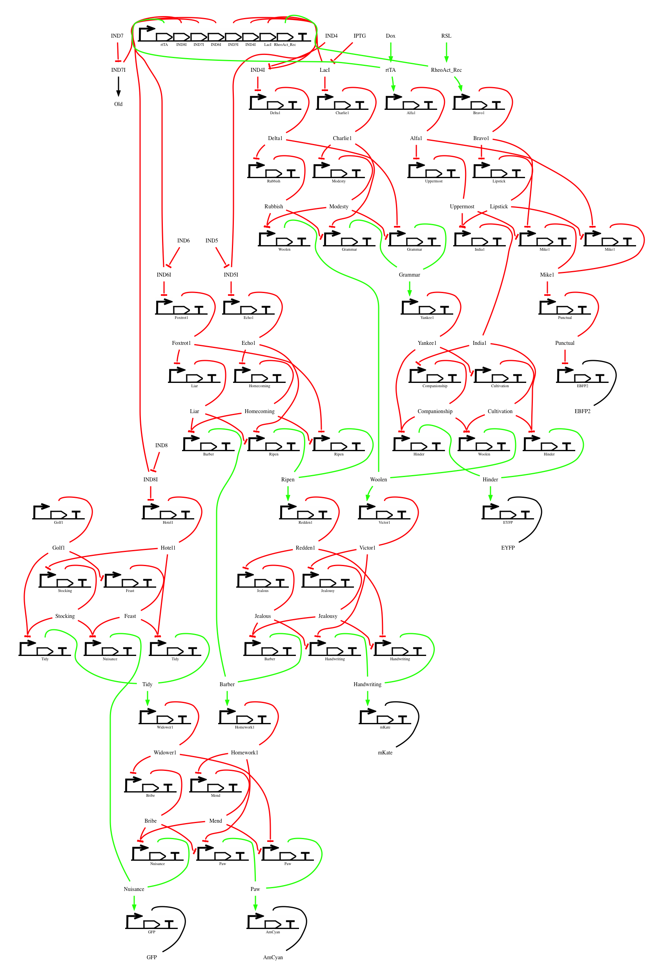
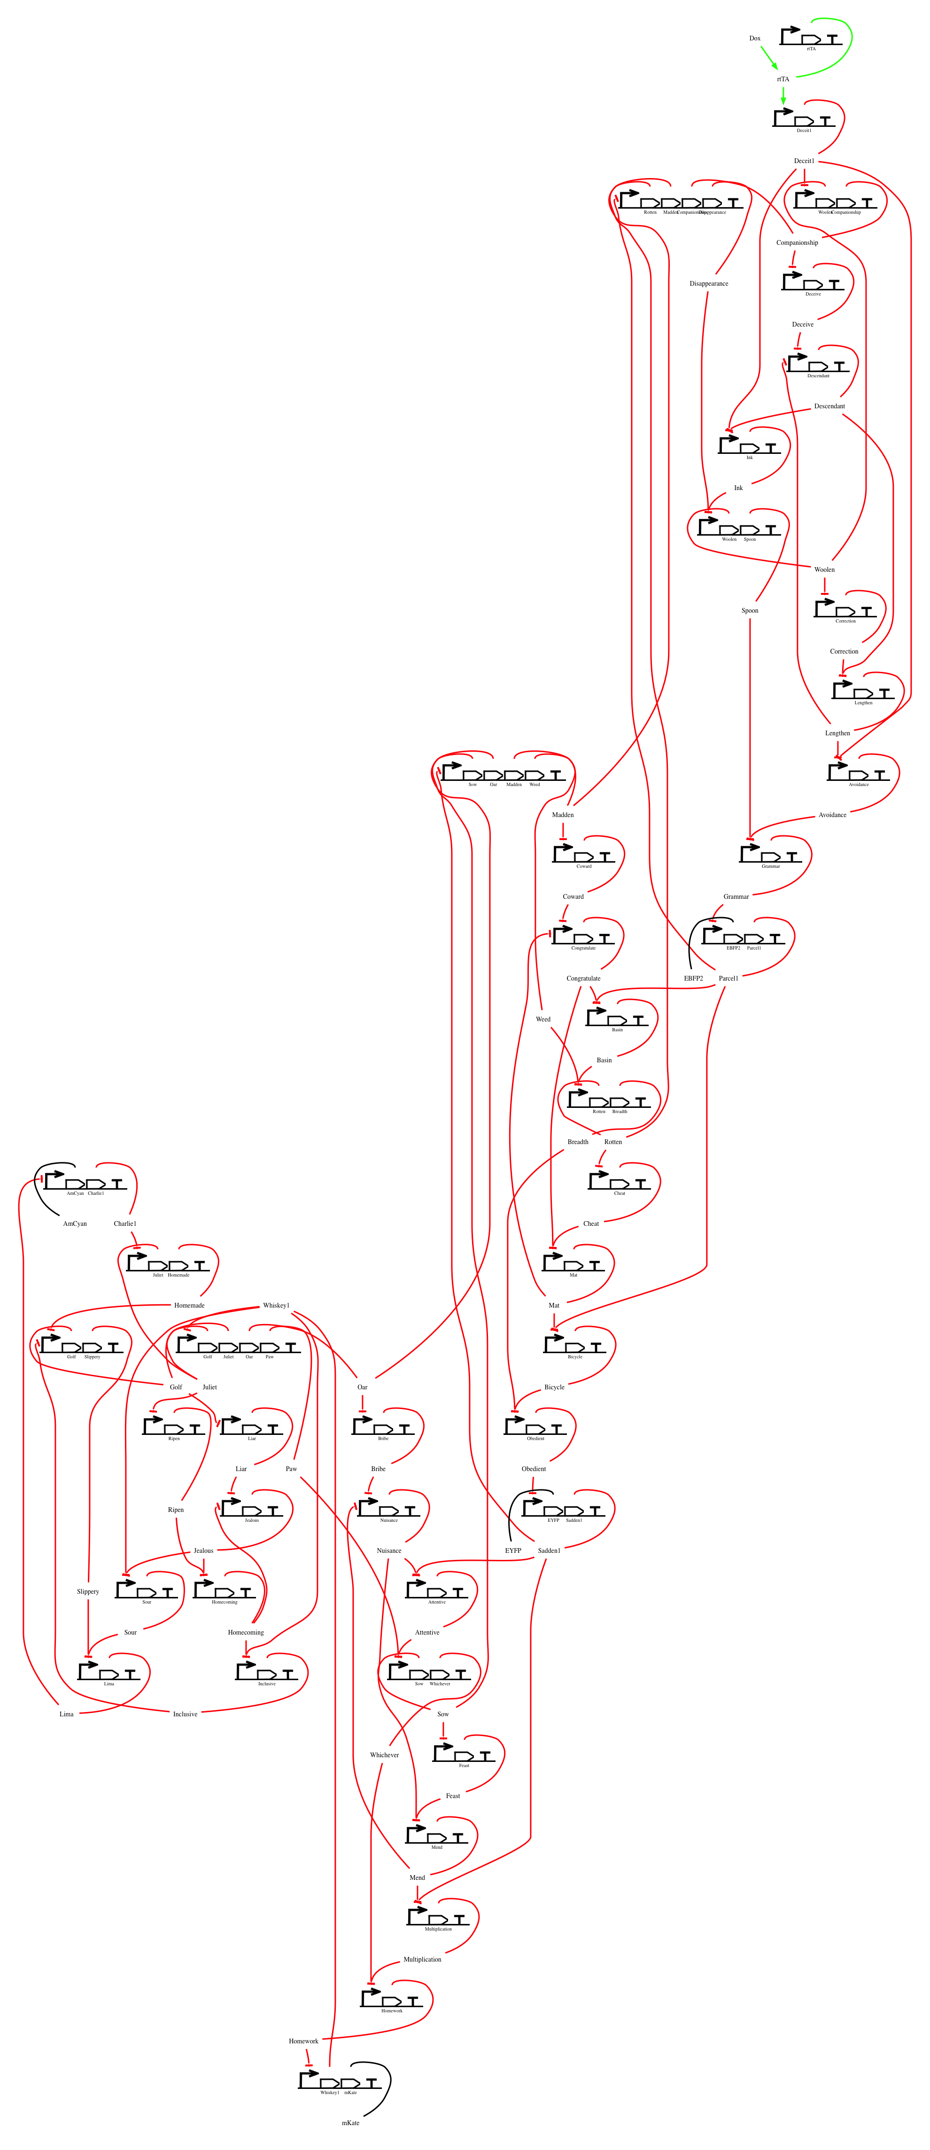
Automated Synthesis of Complex Designs
Example: 4-bit adder
Example: 4-bit counter
Optimized compiler already outperforms human designers

Slide 19
Barriers & Emerging Solutions:
Barrier: Availability of High-Gain Devices
Emerging Solution: combinatorial device libraries based on TALs, ZFs, miRNAs
Barrier: Characterization of Devices
Emerging solution: TASBE characterization method
Barrier: Predictability of Biological Circuits
Emerging solution: EQuIP prediction method

Slide 20
TASBE Method: Calibrated, Precise Characterization
Dox
pCAG
rtTA3
T2A
VP16Gal4
EBFP2
pCAG
mkate
pCAG
pTRE
pTRE
R1
pUAS-Rep1
EYFP
TAL14
TAL21

Slide 21
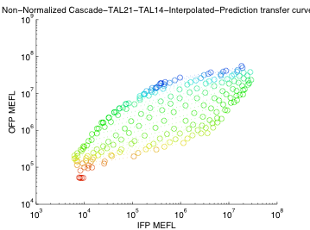
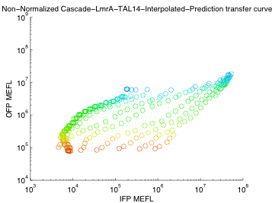
Characterization → High Quality Predictions
Dox
pCAG
rtTA3
T2A
VP16Gal4
EBFP2
pCAG
mkate
pCAG
pTRE
pTRE
R1
pUAS-Rep1
R2
pUAS-Rep2
EYFP
LmrA → TAL14
TAL21 → TAL14

Slide 22
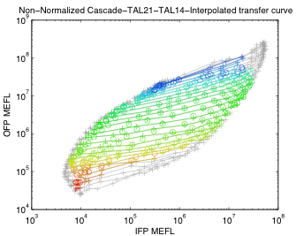
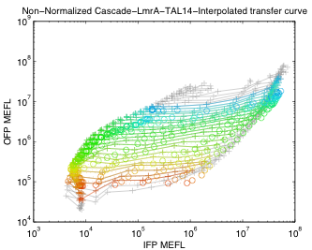
High Quality Cascade Predictions
Dox
pCAG
rtTA3
T2A
VP16Gal4
EBFP2
pCAG
mkate
pCAG
pTRE
pTRE
R1
pUAS-Rep1
R2
pUAS-Rep2
EYFP
LmrA → TAL14
TAL21 → TAL14
Distribution + dynamics models → good predictions

Slide 23
Summary
High-Level BDA is possible now!
EDA tool-chain approach works for BDA
Optimized biological circuits can be generated automatically from high-level specifications
Emerging solutions for key barriers: device libraries, characterization, prediction
Many opportunities for EDA tool adaptation:
Combinatorial device design
Flexible protocol automation
Device characterization
Circuit optimization, verification, safety, debugging

Slide 24
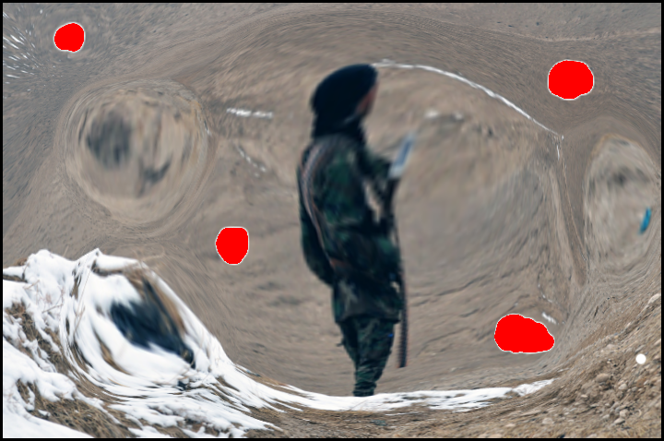

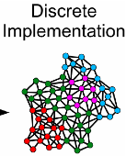

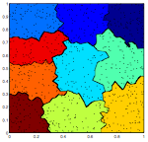
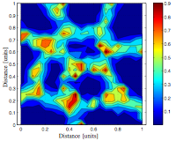
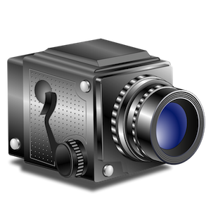
.. and going from cells to processors…
Spatial Computing Process Management
Inference resources focused proportionally on areas of interest
Distortion of computation around temporary and permanent faults
Proto global-to-local
compilation & manifold
computation model
hardware failure
degraded
speed
local heating
ASH volumetric region management
[Pruteanu, Dulman & Langendoen, ‘10]

Slide 25
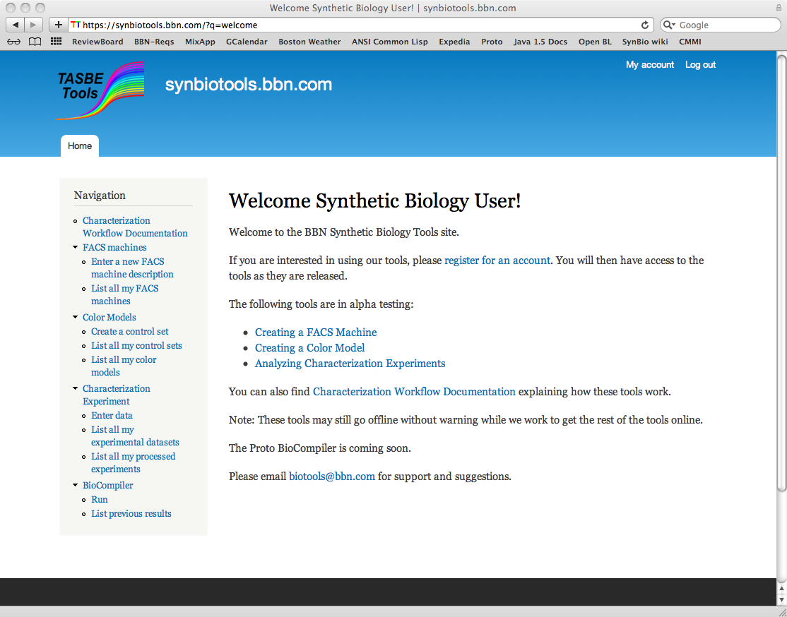
Characterization & Design Tools Online
https://synbiotools.bbn.com/

Slide 26

Acknowledgements:
Aaron Adler
Joseph Loyall
Rick Schantz
Fusun Yaman
Ron Weiss
Jonathan Babb
Noah Davidsohn
Ting Lu
Douglas Densmore
Evan Appleton
Swapnil Bhatia
Traci Haddock
Chenkai Liu
Viktor Vasilev

